Slide 1









Task Hijackig in Android
ANSHIKA VERMA

Slide 2





Open-source operating system
Based on the Linux kernel

Slide 3




Intro
Anshika Verma
- Associate Security Analyst
@CloudSEK

Slide 4




Objective

Slide 5


Terms to know
Activity
Task
Represents a single screen with a user interface (UI) in an Android application.
A collection of activities that are grouped together and managed as a unit by the Android system

Slide 6
Terms to know
Intent
Instance
A message or communication object that is used to request an action or to pass data between different components in an Android application
When we talk about
instances in the context
of launch modes, we are
referring to instances of
activities. Each time an
activity is created
and added to the
task stack, it is an instance
of that activity

Slide 7
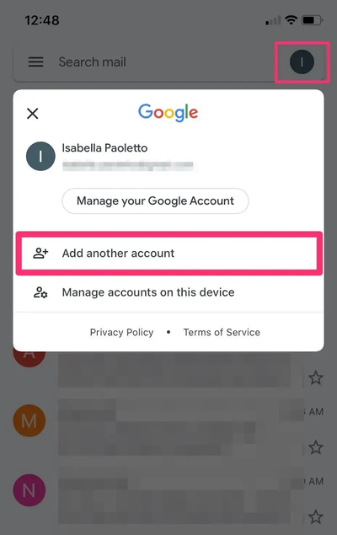
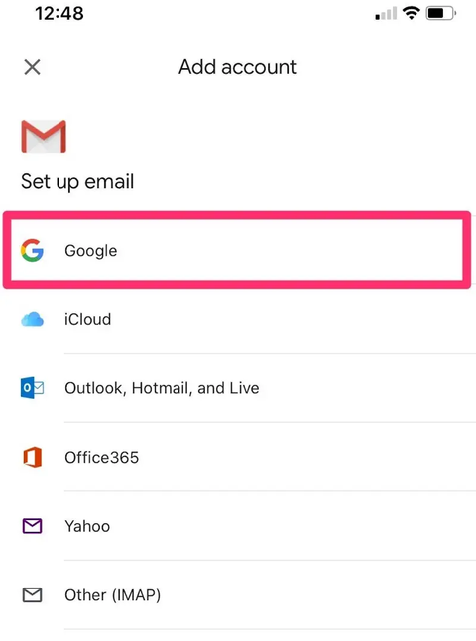
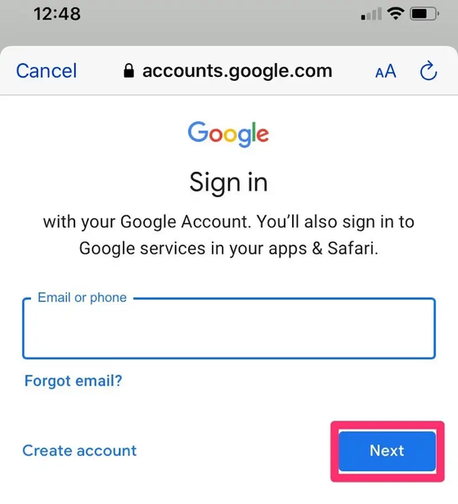
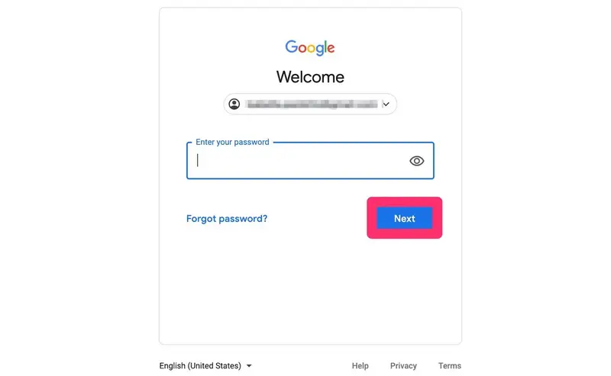
Example
Consider Gmail login task.
Activity 1
Activity 2
Activity 3
Activity 4
Task - A

Slide 8
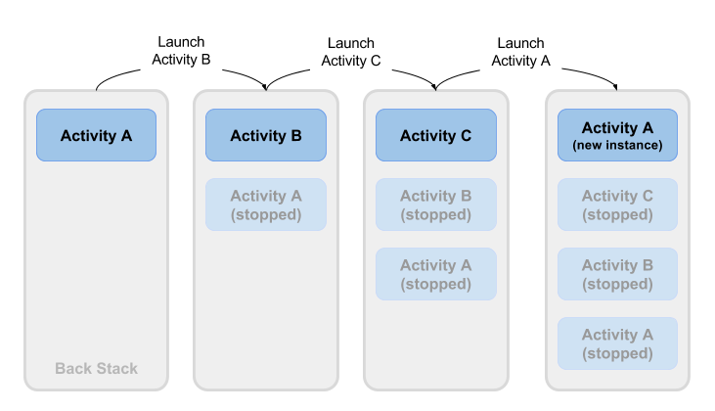
Launch
Launch
Launch
Activity 3
Activity 4
Activity 3
Activity 2
Activity 3
Activity 4
Activity 3
(new instance)
Activity 1
Activity 2
Activity 3
Activity 4
Activity 1
Activity 2
Activity 3
Activity 1
Activity 2

Slide 9


Launch modes
standard
singleTop
singleTask
singleInstance

Slide 10


Standard : Home Screen -> Product Details -> Cart
: Home Screen -> Product Details -> Cart -> Product Details
Single Task : Home Screen -> Product Details -> Cart
: Home Screen -> Product Details -> Cart -> Product Details
Single Top : Home Screen -> Product Details -> Cart
: Home Screen -> Product Details -> Cart -> Product Details
Single Instance : Home Screen -> Product Details -> Cart -- (task A)
: Home Screen -> Product Details -- (task B)

Slide 11

Task Hijacking
Task interception or task stealing is a security vulnerability that occurs when a malicious app or component takes control of another app's task or user interface (UI) without the user's knowledge or consent

Slide 12

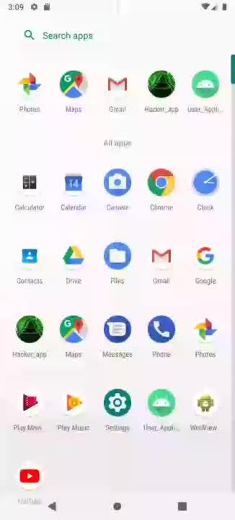

Demo

Slide 13




Mitigations
Regularly Update Devices and Apps
Download Apps from Trusted Sources
Be Cautious of App Permissions
User Awareness and Vigilance
Implement Secure Coding Practices
Regular Security Testing

Slide 14


THANK YOU
SPECIAL MENTIONS
NULL
SAURABH
AARUSHI KOOLWAL
PAWAN KARTHIK M
DANIEL DOMINIC
CLOUDSTERS

